Slide 1
Easy Poll
Group 6: Yuanting Liu, Ruichen Qu, Minyu Chen, Laxmi Anukruti Vadali
Notes:
Hello everyone, today we are Group 6, and we are going to present our project Easy Poll.

Slide 2
Introduction
Prototype
Live Demonstration
Usability Test
Notes:
the first part is introduction
Easy Poll is a simple web-based polling application designed to support quick interaction in group settings.
In this presentation, we will first give a short overview of the system, then walk through the main user flows, and finally share the results of our usability testing and what we learned from it.

Slide 3


Context Assumptions
Quick quiz
Knowledge check
Introductory quiz
Team-based quiz activity
Notes:
This slide presents the context assumptions for Easy Poll.
We assume that the system is mainly used in live, shared environments, where one person is presenting and others participate at the same time.
One common context is a quick quiz or knowledge check, for example during a lecture, a workshop, or a presentation. In this situation, the goal is not formal assessment, but rather to quickly check understanding or keep the audience engaged.
Another context is an introductory or team-based quiz activity, such as ice-breaking sessions or small group events. Here, the focus is on participation and interaction in a relaxed and informal setting.
Across these contexts, interactions are typically short and time-constrained, and users expect the system to work smoothly without interrupting the ongoing session.

Slide 4
User assumptions
Used by presenters and audience during the same session
Users have basic experience with smartphones or web applications
No prior training is required to use the system
Users can access the system on mobile devices or desktop computers
Notes:
As for the user assumptions,
We assume that Easy Poll is used by presenters and audience members during the same session, with clearly defined roles.
Users are expected to have basic experience with smartphones or web applications, but no technical background is required.
We also assume that no prior training is needed, and users should be able to understand the system immediately.
Finally, users may access the system on either mobile devices or desktop computers, which is why the interface is designed to be responsive and device-independent.

Slide 5
Introduction
Prototype
Live Demonstration
Usability Test

Slide 6
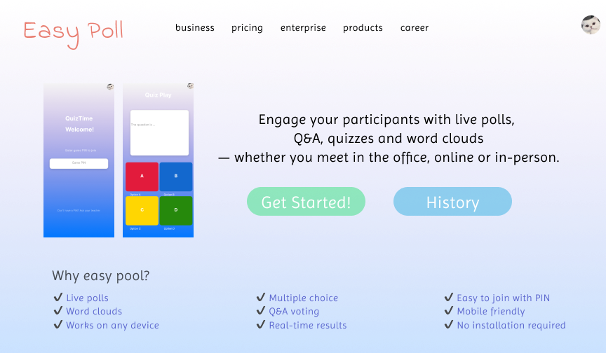
Initial Prototype—Main Page

Slide 7
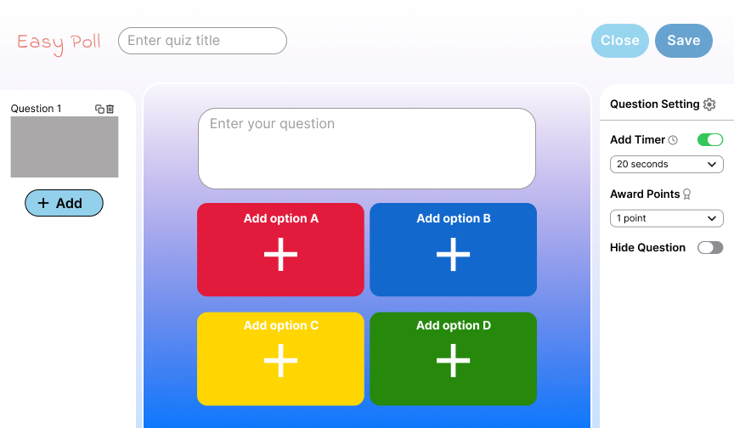
Initial Prototype—Create Page

Slide 8
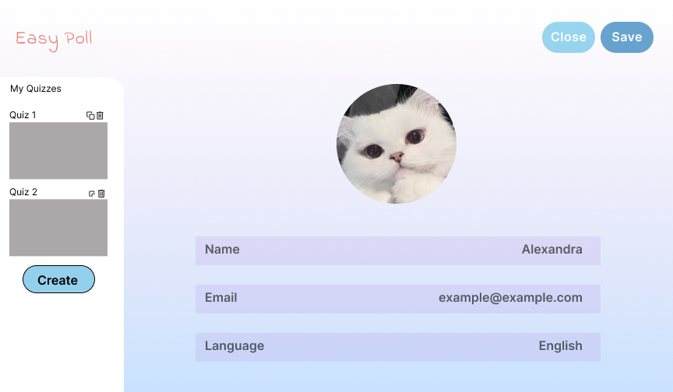
Initial Prototype—Profile Page

Slide 9
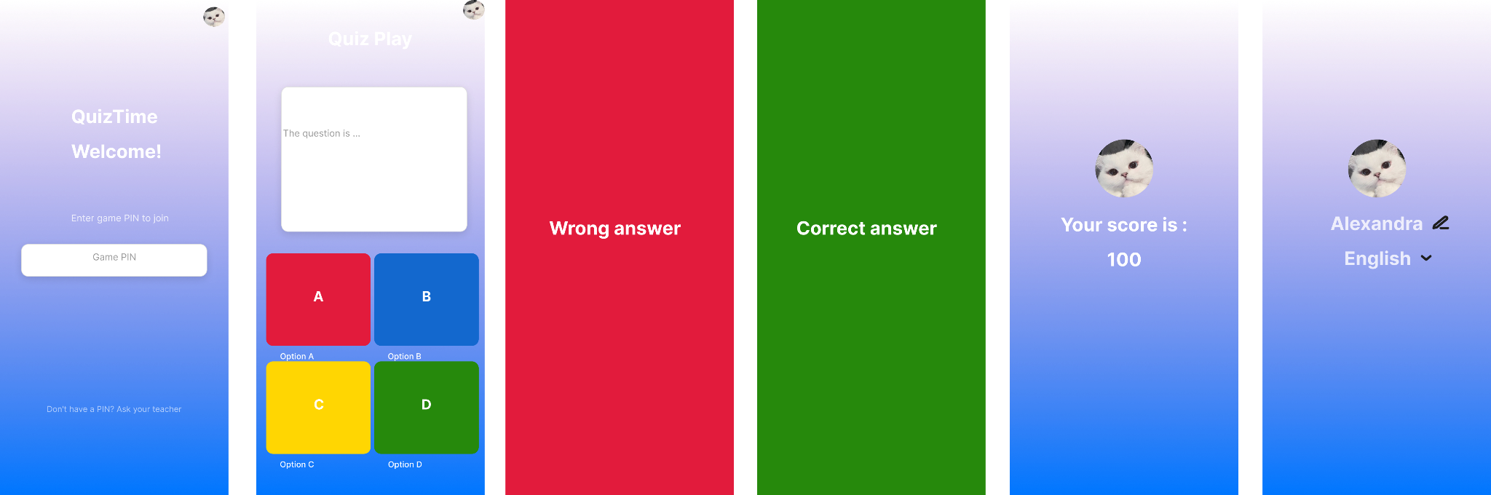
Initial Prototype—User View (Join + Play + Result + Profile)

Slide 10
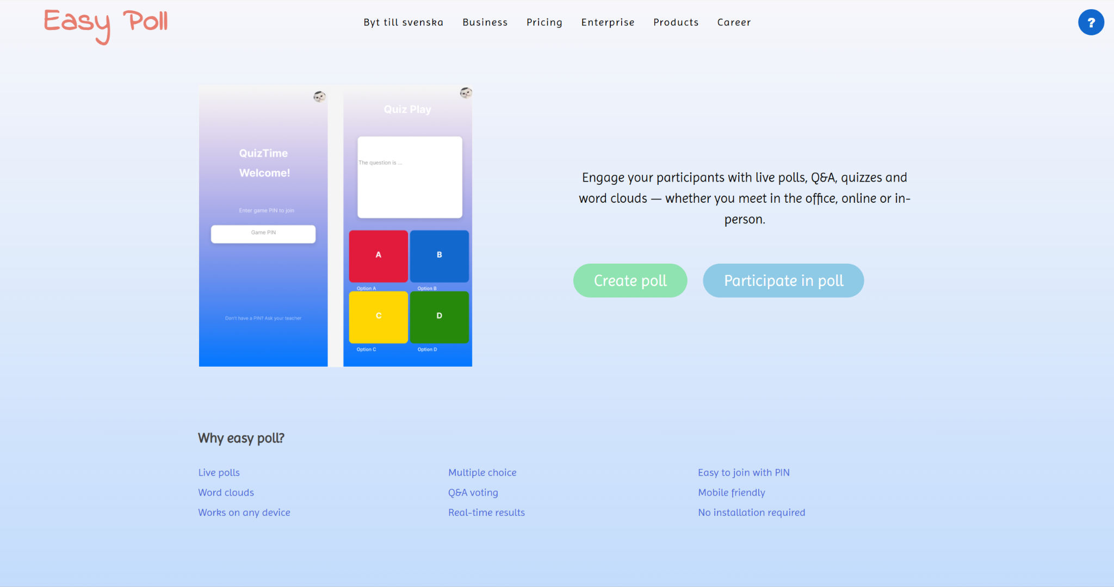
Initial Prototype VS Final System
Delete the ‘History’ button
Make the two main functions more obvious → easy and quick start
Notes:
We chose not to include a history feature because Easy Poll is meant for quick, one-off polls. Users can start or join a poll immediately without creating an account.
In our initial prototype, the admin view was only available on desktop, while the user view was designed mainly for mobile use. However, we later realized that this device restriction was unnecessary and could limit flexibility. In the final system, both admins and participants can use Easy Poll on either desktop or mobile, which provides a more consistent and accessible experience.

Slide 11
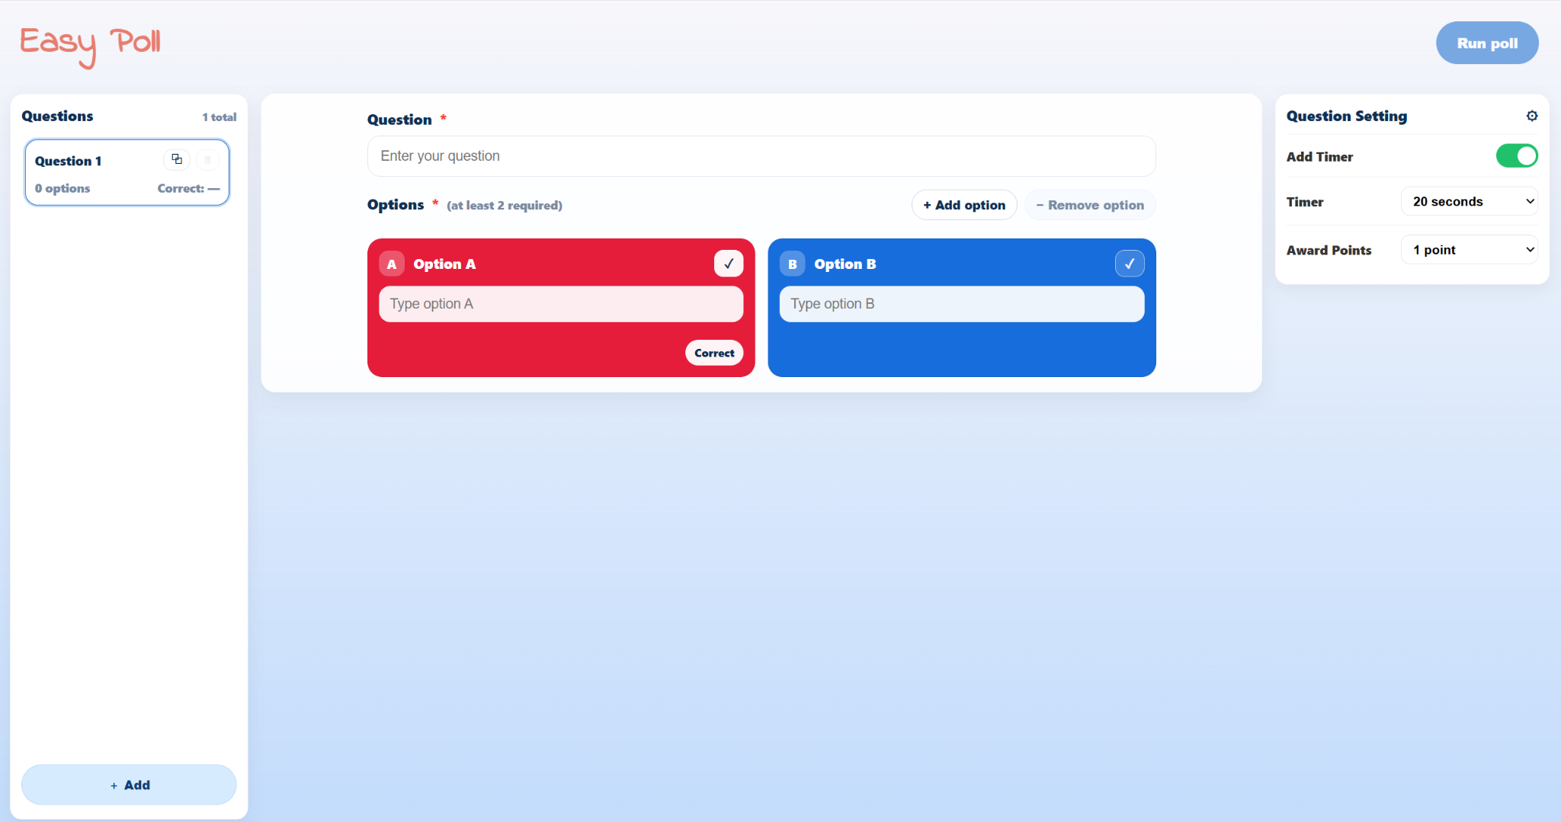
Initial Prototype VS Final System
Replace ‘Save’ with ‘Run poll’
Allow flexible option amounts
Notes:
In the initial prototype, the main action was labeled as “Save”, which was a bit unclear for users. In the final system, we replaced it with “Run poll”.
We also removed the fixed four-option structure and allowed flexible option amounts, so users can design polls that better fit their actual needs.

Slide 12
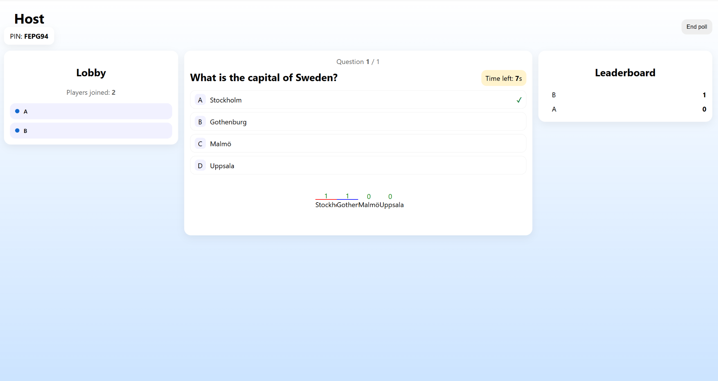
Initial Prototype VS Final System
Host view → Monitor the poll in real time
Notes:
In the final system, we also added a host view. This allows the host to monitor and control the poll in real time. Here we have lobby that shows how many people have joined, as well as the current question, participant answers, and the leaderboard.

Slide 13
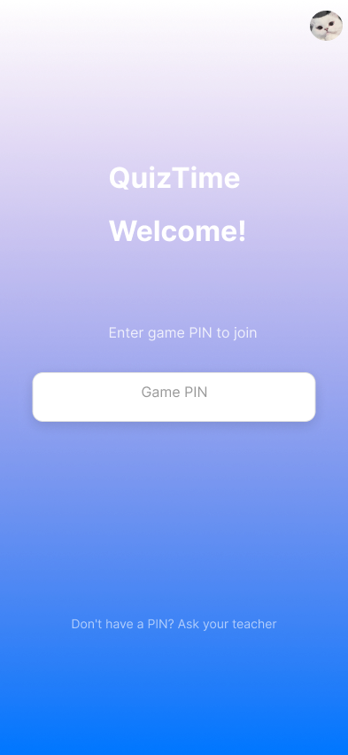
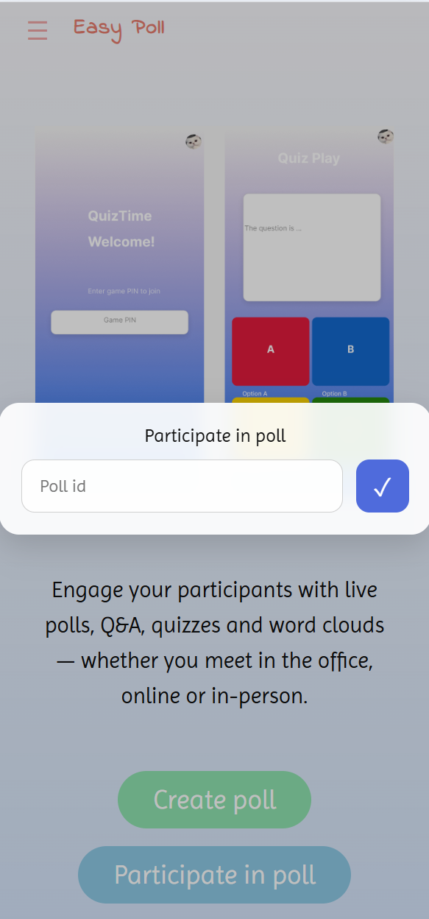
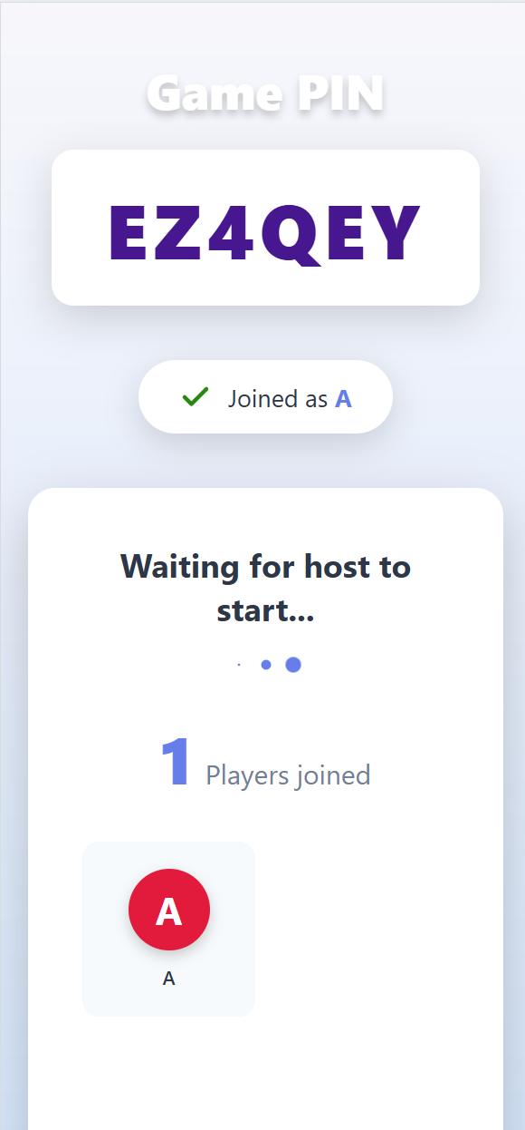
Initial Prototype VS Final System
Add a Lobby page after entering the Game PIN

Slide 14
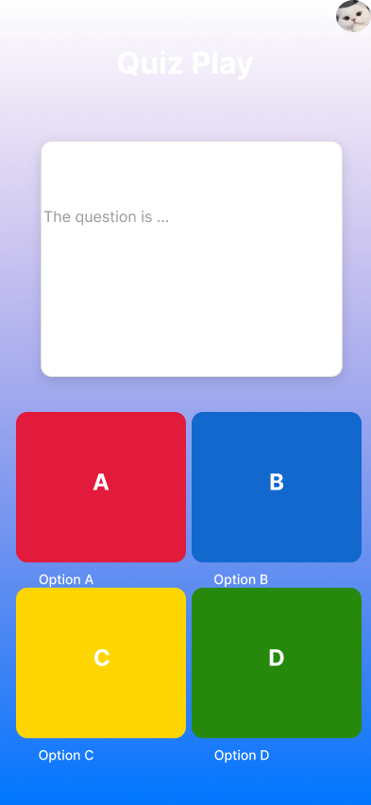

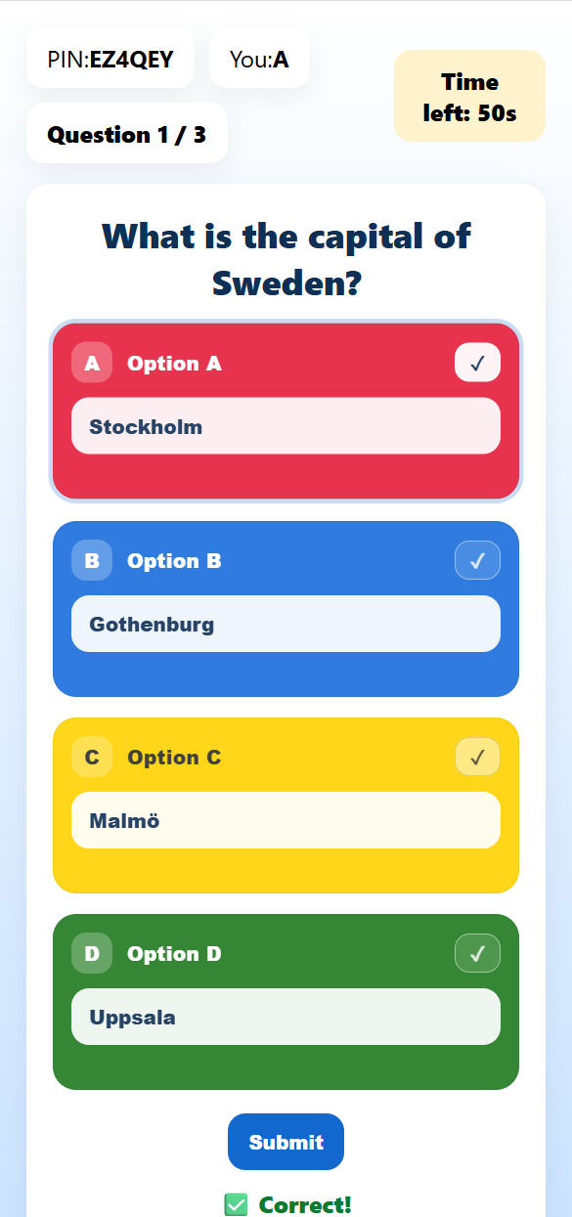
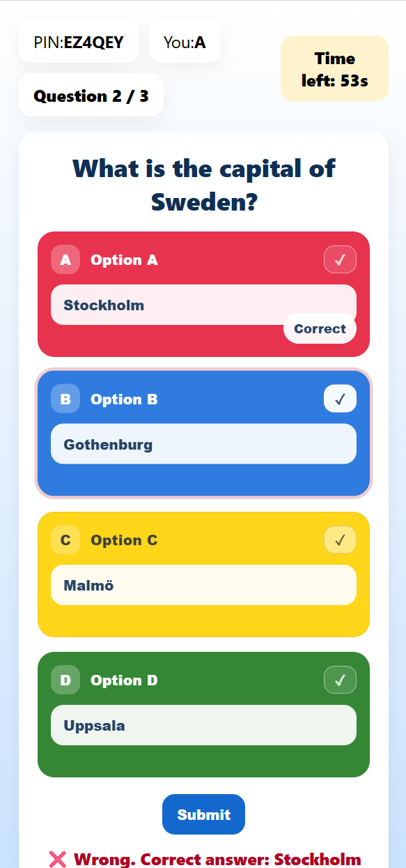
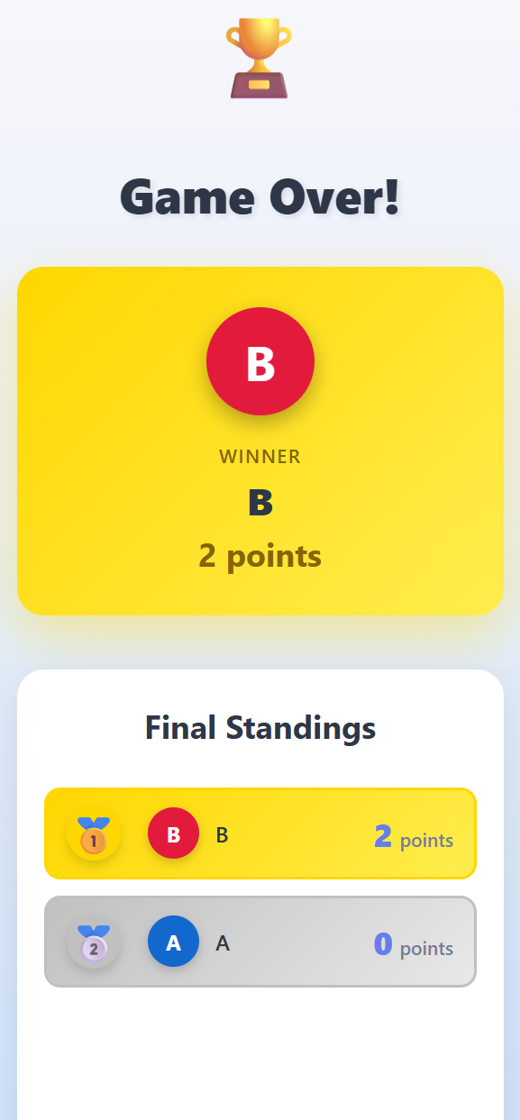
Initial Prototype VS Final System
Display a countdown timer when the admin sets a time limit
Show ranking at the end of the game, not just the results

Slide 15
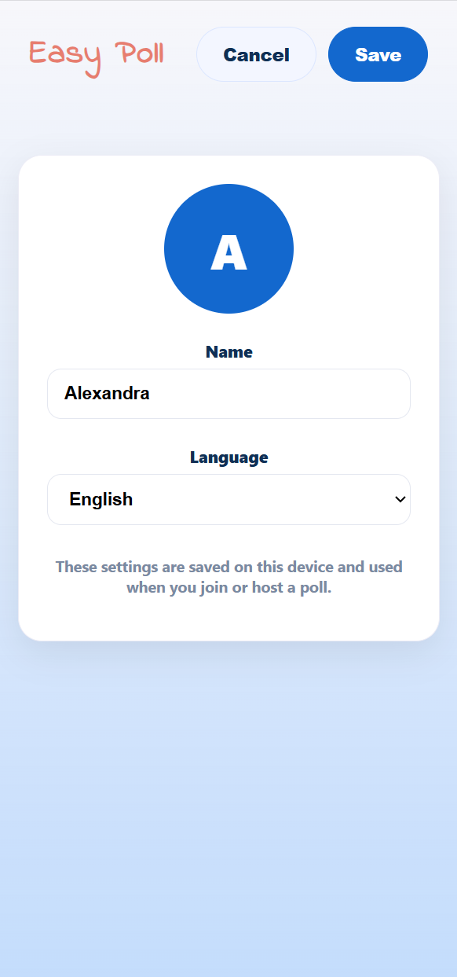

Initial Prototype VS Final System
Do not store quiz history
Remove the email field as login is not required

Slide 16
Introduction
Prototype
Live Demonstration
Usability Test

Slide 17
Demo
A quick demo of the SYSTEM

Slide 18
Introduction
Prototype
Live Demonstration
Usability Test

Slide 19
Usability Test Overview
4 participants
Desktop and mobile-sized interfaces
Participants acted as both presenter and audience
Core tasks: editing profile, creating, joining, and participating in polls
Notes:
I’ll show a brief overview for Usability Test
The test was conducted with four participants, using both a desktop web interface and a mobile-sized interface simulated in the browser.
Due to technical limitations we can only run our project locally. So all the participants performed both presenter and audience roles.
The test focused on core tasks, including editing profile, creating quizzes, joining with a code, answering questions, and viewing results.

Slide 20
Key Findings
Core tasks were completed successfully on both web and mobile
Web interface was immediately understandable
Mobile interface showed visibility issues on the start view
Some confusion during poll creation and timed transitions
Notes:
And here are the key findings.
Overall, participants were able to successfully complete all core tasks on both the web and mobile interfaces. Creating and participating in a poll was generally smooth, and users could understand the basic workflow without external assistance.
The web interface performed particularly well, as participants could immediately locate the main actions and proceed without hesitation.
On the mobile interface, however, some usability issues were observed. Participants initially experienced small delays because the main entry buttons were positioned lower on the page and required scrolling to become visible.
During poll creation, one participant hesitated when trying to create a multiple-choice question, as only single-choice questions were supported.
Additionally, during quiz participation, some users expected the system to automatically move to the next question once all answers were submitted. However, in the current system, the quiz always waits for the countdown timer to finish.

Slide 21
Possible Improvements
Improve visibility of main actions on mobile
Support more flexible question creation, including multiple-choice questions, image-based questions, and image options
Provide clearer feedback during timed transitions
Offer user history and past quiz records for review
Notes:
Based on the usability test results, we identified several possible improvements.
These include improving the visibility of main actions on mobile devices, and supporting more flexible question creation, such as multiple-choice and image-based questions.
We also see a need for clearer feedback during timed transitions.
Finally, offering access to user history and past quiz records could help users review previous interactions and improve the overall experience.

Slide 22
Thanks for your listening！

